Slide 1




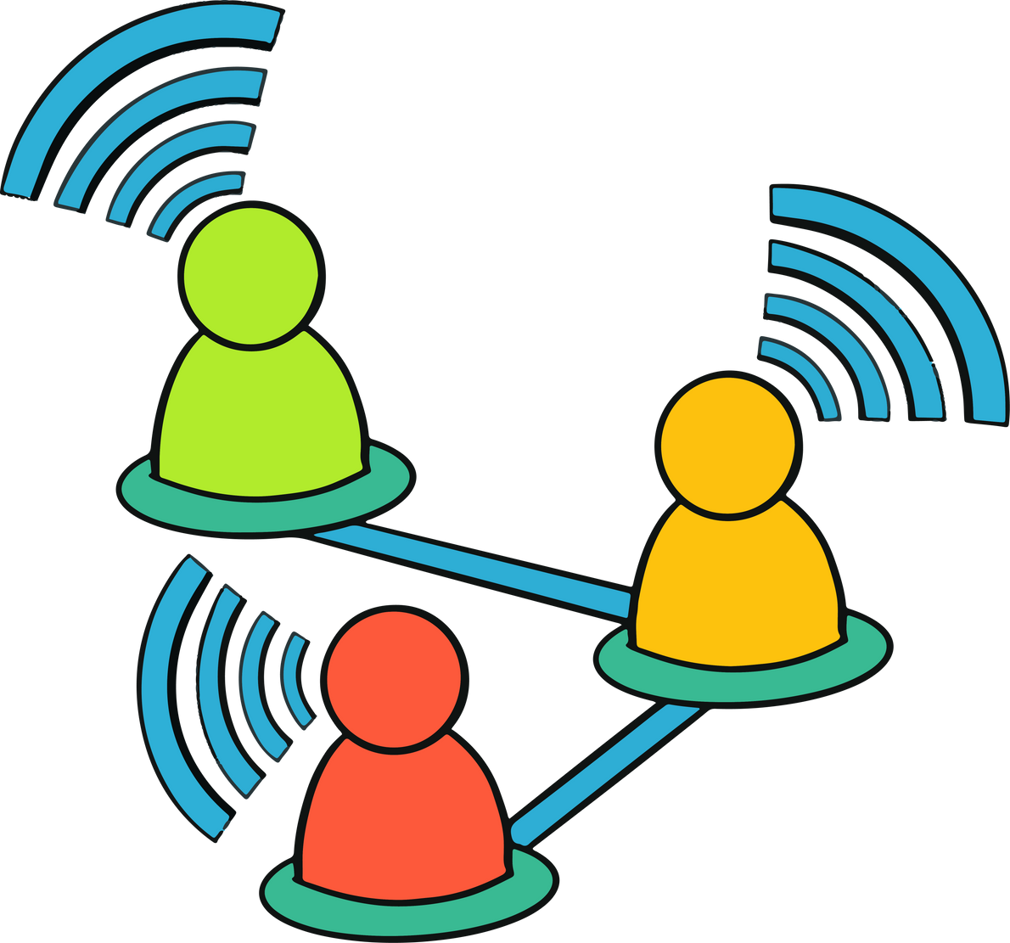




CSE-3111: COMPUTER
NETWORKING PROJECT
Project Presentation of
Net-Classroom
Building a Networked Classroom System
Presented By:
Aditto Raihan(09)
Jubair Ahammad Akter (59)
January 2026

Slide 2



Area of Focus
01
PROBLEM DOMAIN & MOTIVATIONS
02
OBJECTIVES/AIMS
03
Project Features
04
Block Diagram/ Work Flow Diagram
05
TOOLS & TECHNOLOGIES
06
Applied Networking Concepts
07
Some Major Output SS with some captions.
08
Limitations and Future Plan.
Net-Classroom

Slide 3



Net-Classroom
The Problem Domain:
Bridging Communication Gaps
Online Classrooms
Existing System Limitations
Hidden Complexity
Online classrooms require real-time communication, assignment management, and secure interaction between teachers and students.
Understanding low-level networking concepts is often hidden in high-level tools.
Many existing systems rely on heavy web frameworks and external services.
1

Slide 4


Net-Classroom
Core Objectives and Aims
TCP-based Design
Real-time Chat
Interactive Features
To architect a robust TCP-based system capable of managing all aspects of a digital classroom.
To enable fluid, instantaneous communication among all participants within the classroom environment.
To facilitate diverse teacher-student interactions, including announcements, private messaging, and assignment creation.
Data Integrity
Client Versatility
Group Assignment
To ensure reliable data transfer and robust connection handling, critical for educational content and communications.
To develop both terminal-based and JavaFX GUI-based clients for varied user access and experience.
To ensure reliable data transfer and robust connection handling, critical for educational content and communications.
2

Slide 5













Key Project Features: Enhancing the Learning Experience
User Authentication
Classroom Chat
Login with distinct role-based access for Teachers and Students.
A public chat channel for general announcements and discussions among all participants.
Submission & Tracking
Private Messaging
Robust file upload for assignment submissions and real-time status tracking for teachers.
Direct, secure communication between students and between teachers and students.
Group Creation
Assignment Management
Dynamic group formation capabilities to facilitate collaborative projects.
Creation and distribution of both solo and group assignments.
The system will initially feature a basic terminal-based client for core functionality, evolving into an enhanced JavaFX GUI client to provide a richer, more intuitive user experience.
3

Slide 6
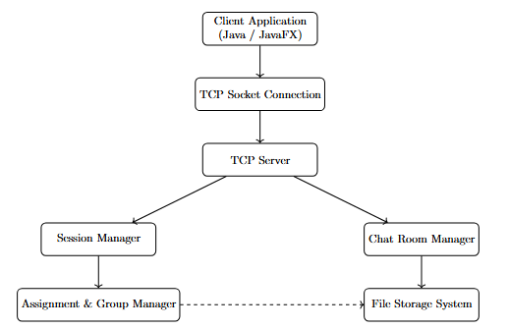
Net-Classroom
Block Diagram
Workflow
Client connects to server using TCP socket
User joins classroom with role (student/teacher)
Server maintains active sessions
Client sends requests using custom HTTP-like protocol
Server processes request and responds accordingly
Messages and files are transferred reliably over TCP
Server broadcasts or routes messages based on type
4

Slide 7




Net-Classroom
Technology Stack: Tools of the Trade
Programming Language: Java
Networking: TCP Sockets
User Interface: JavaFX
Development Tools
Utilizing java.net.Socket and ServerSocket for direct, low-level client-server communication, ensuring connection-oriented and reliable data exchange.
For the graphical user interface client, JavaFX offers a rich set of UI components and powerful capabilities for building engaging desktop applications.
Integrated Development Environments like IntelliJ IDEA and VS Code provide comprehensive support for coding, debugging, and project management, alongside standard command-line tools (javac, java).
Chosen for its robustness, platform independence, and extensive networking capabilities, Java forms the backbone of our system.
Beyond these core technologies, the project involves custom parsing for an HTTP-style request/response protocol and extensive file I/O operations for handling assignment submissions, demonstrating a full-stack approach to network application development.
5

Slide 8







Net-Classroom
Networking Concepts in Action
Socket Programming
Client-Server Architecture
This project serves as a practical demonstration of fundamental networking theories. From establishing persistent socket connections for each client to the server, to managing the lifecycle of user sessions, every component is meticulously crafted to exemplify these concepts.
Reliable Data Transfer
Flow Control
Congestion Control
Session Management
Multiplexing
6

Slide 9
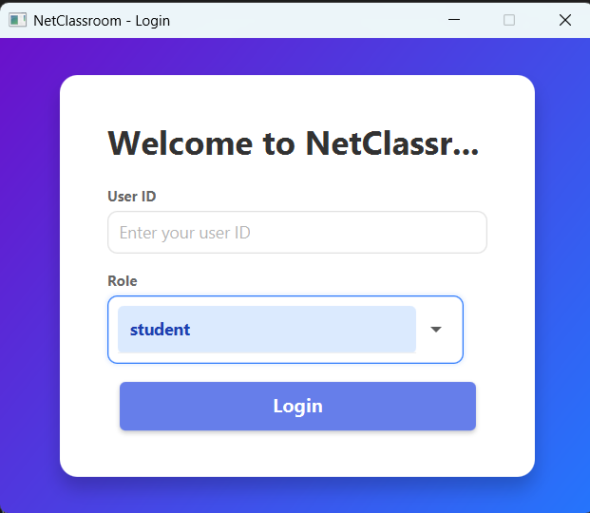
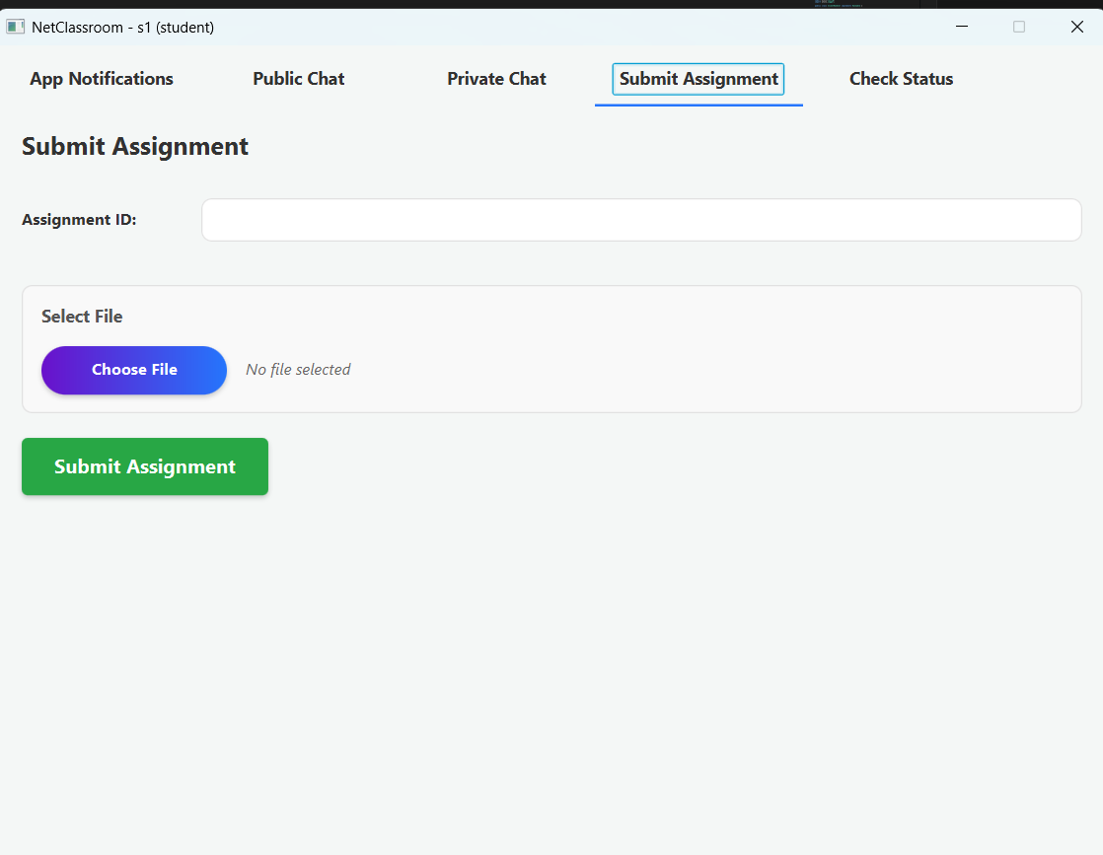
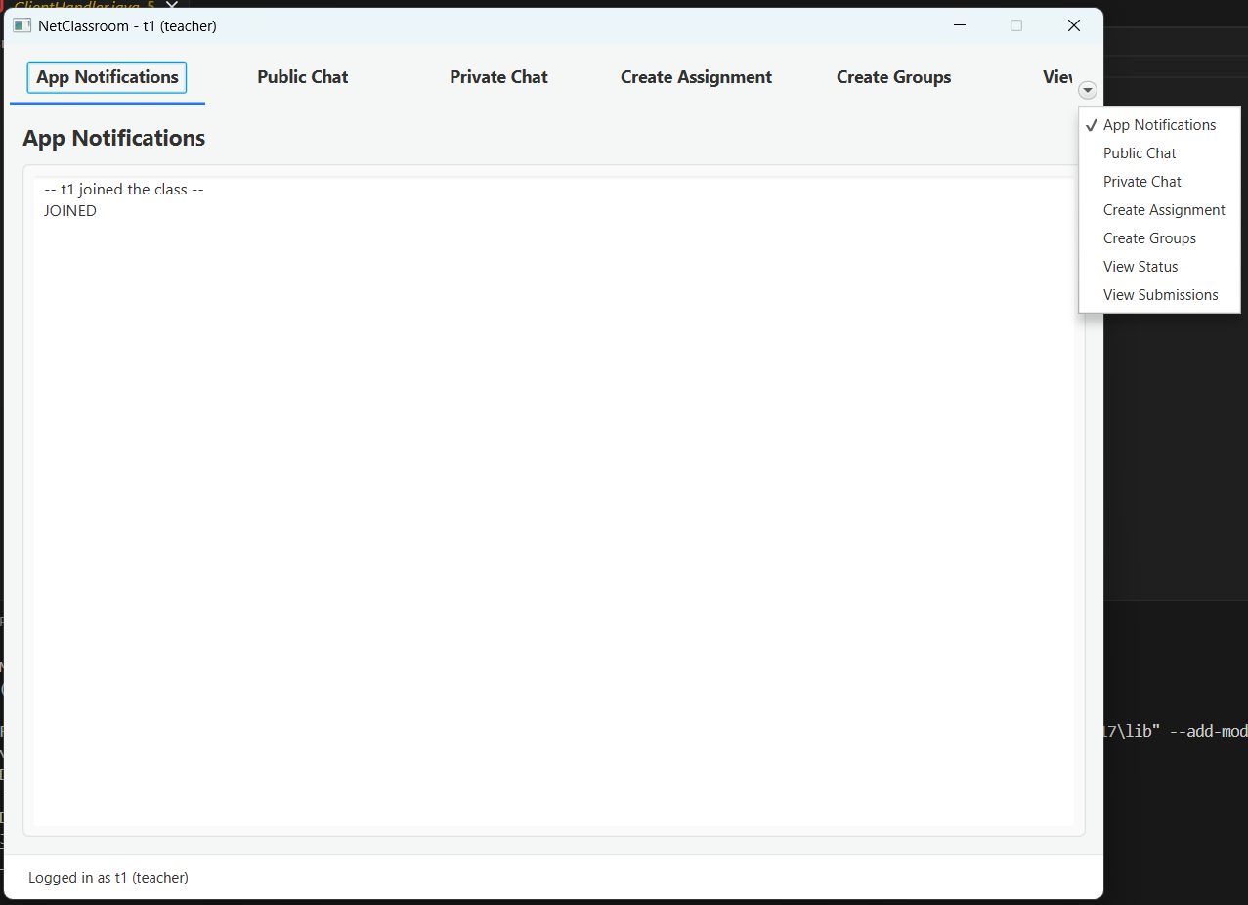
7
Net-Classroom
Screenshots of
Dashboards

Slide 10
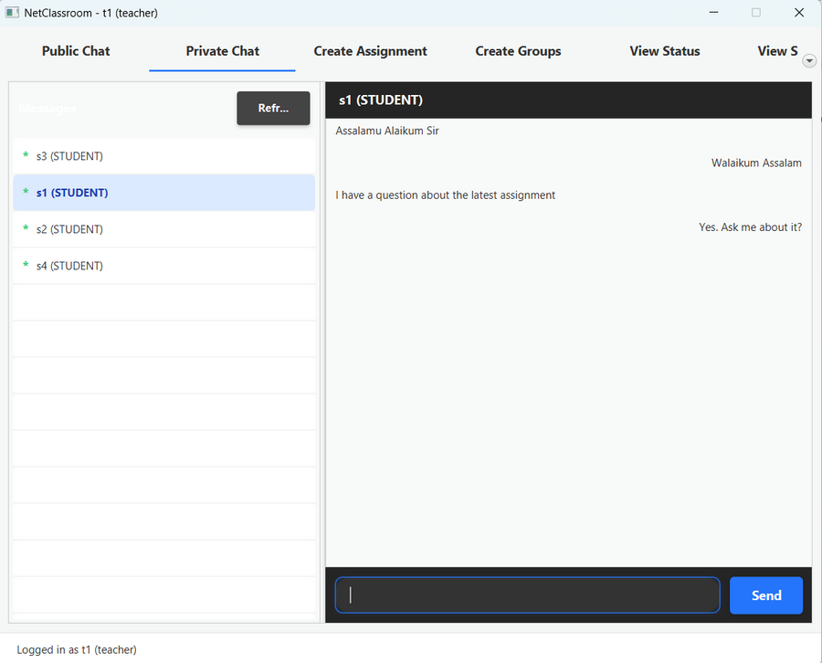
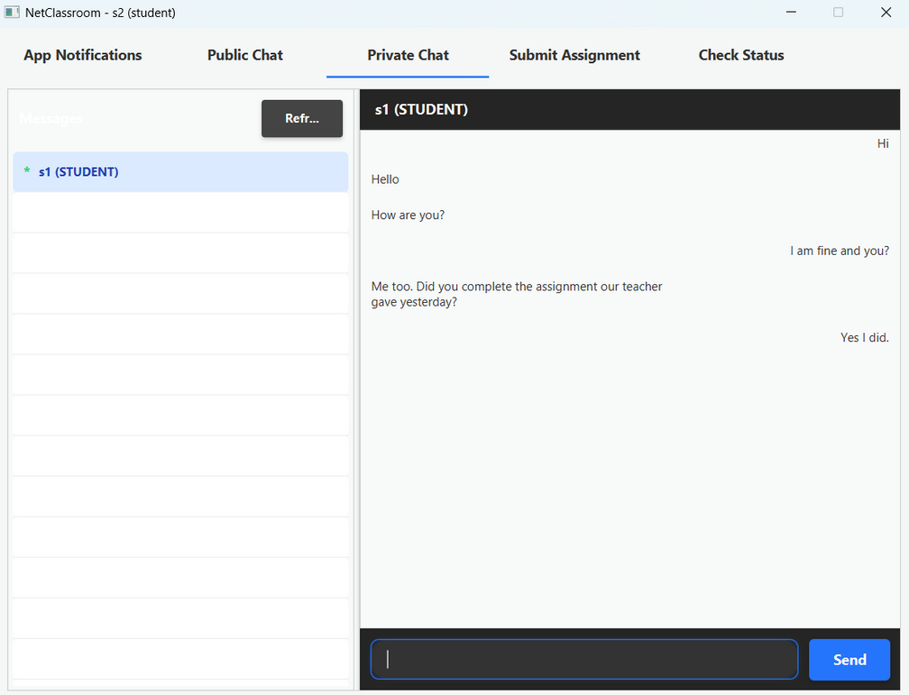
8
Net-Classroom
Screenshots of Chattings
Teacher to Student
Student to Teacher

Slide 11
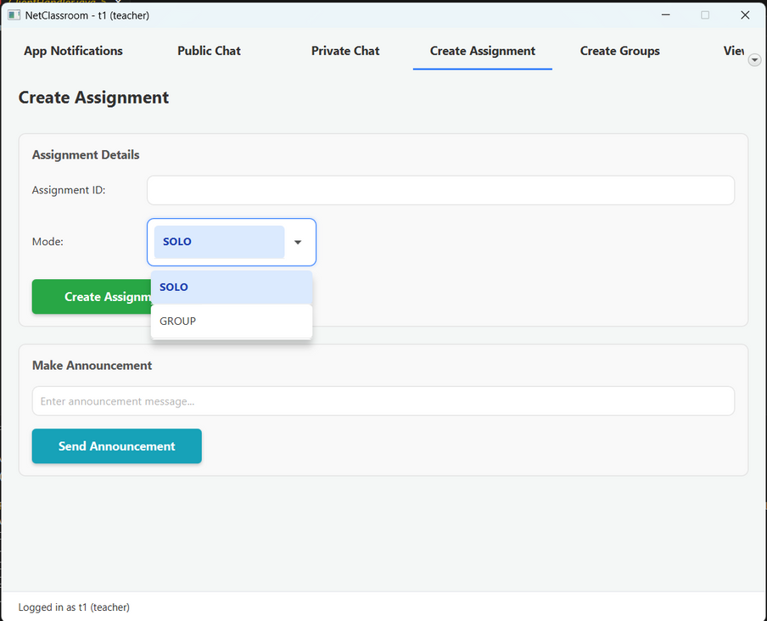
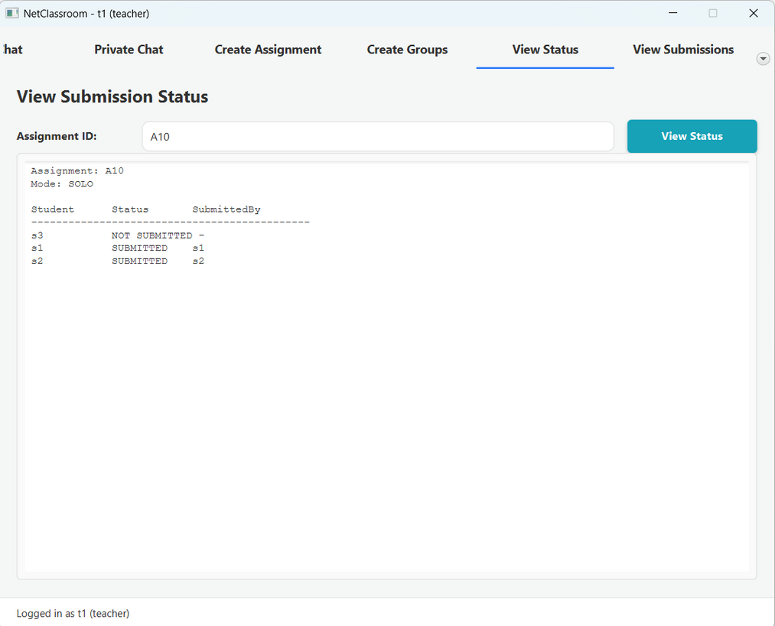
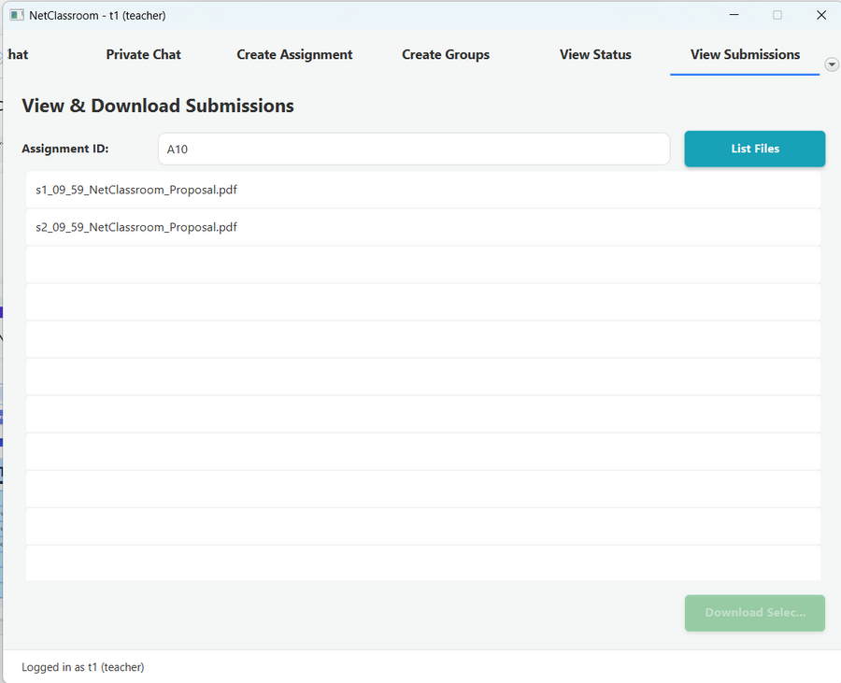
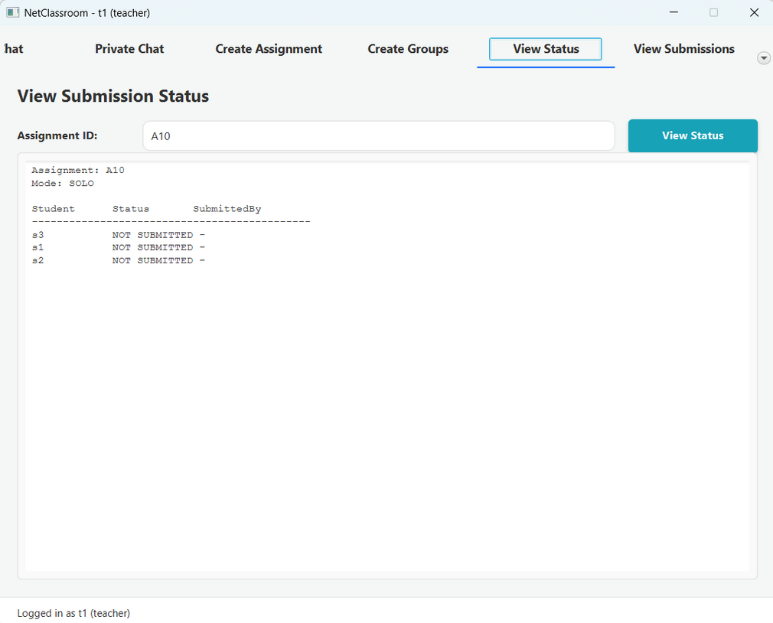
Net-Classroom
8
Screenshots of Solo Assignment

Slide 12
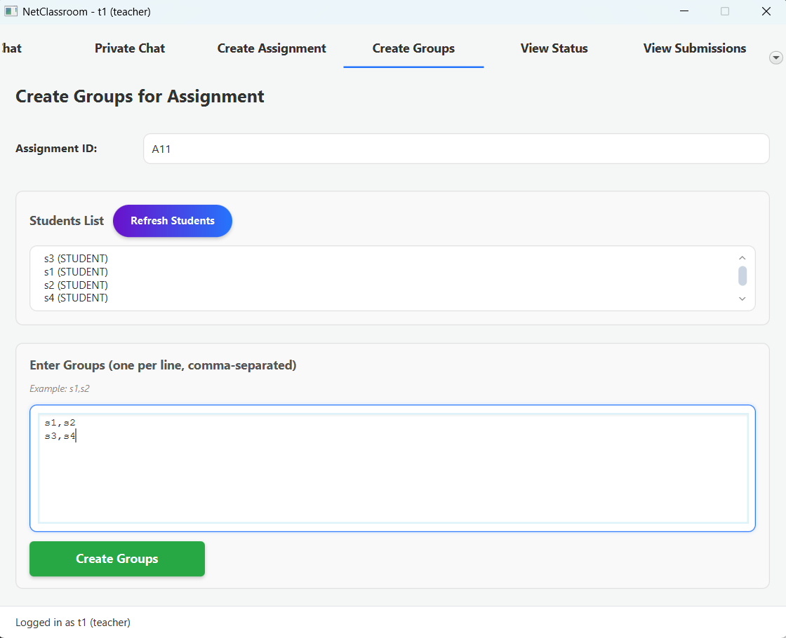
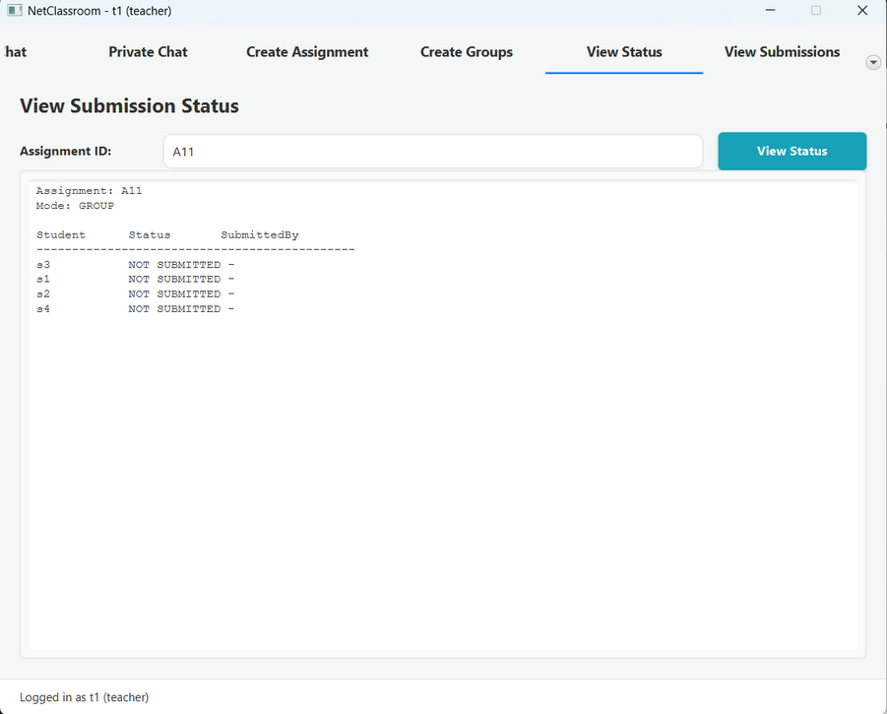
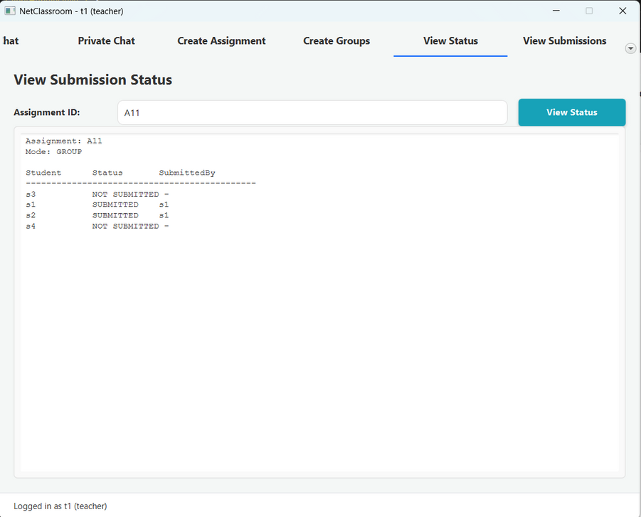
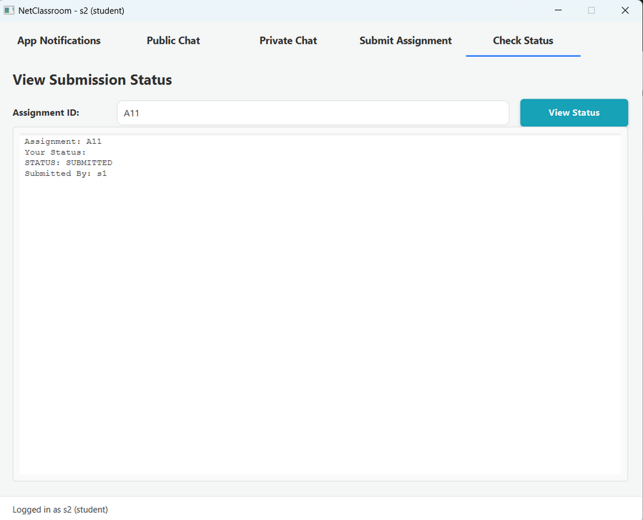
10
Net-Classroom
Screenshots of Group Assignment

Slide 13
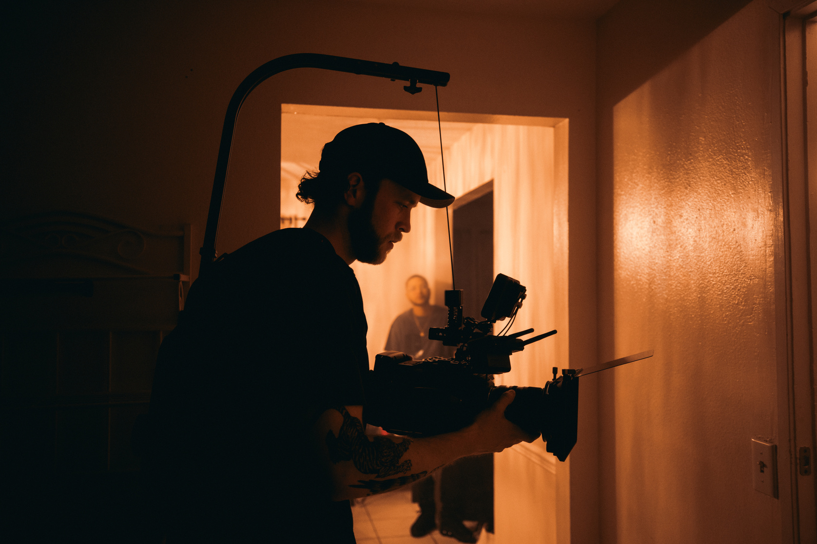

Net-Classroom
Current Limitations & Future Horizons
Security &
Privacy
User
Interface
Currently, data is transmitted in plain text, lacking encryption. This is a critical area for improvement to ensure secure communication.
The current UI design is basic and not web-based, limiting accessibility and modern aesthetic expectations.
Data Persistence
Scalability
The system has limited scalability, not yet optimized for very large classrooms or extensive user bases.
Data is primarily stored in memory or local files, lacking robust persistent storage solutions like a database.
11

Slide 14

Net-Classroom
THANK
YOU
CSE-3111: COMPUTER
NETWORKING PROJECT

